Slide 1
Imbalance data and how to handle it
Data science, Machine learning & AI knowledge sharing #1
Speaker: Peerapat.t, Data analyst at Kasikorn asset management (KAsset)
Level: Advance

Slide 2
Agenda
What is imbalance data
Example scenario
Problems of imbalance data
How to handle imbalance data***
Show case
Further reading
Appendix

Slide 3
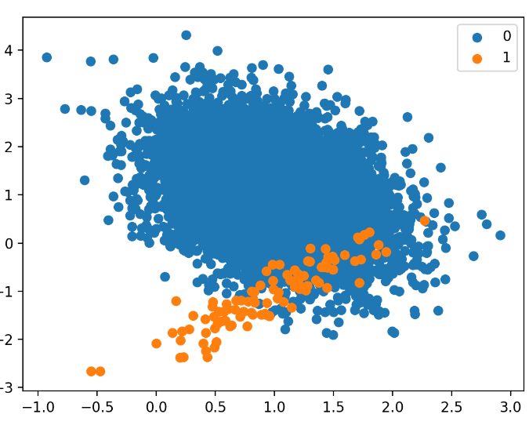
What is Imbalance data
Imbalanced data refers to a situation in a dataset where the classes are not represented equally.
Characteristics
Majority Class: The class with the most instances.
Minority Class: The class with fewer instances.

Slide 4
Example Scenario
Fraud Detection in Credit Card Transactions
Spam Detection in Emails
Detection of Rare Diseases
Churn prediction model
Propensity-to-buy model

Slide 5

Problems of imbalance data
Poor Model Performance
Bias in Performance Metrics
Example Scenario:
Fraud Detection Consider a dataset for credit card transactions with the following distribution: Legitimate transactions (Majority class): 98,000 instances Fraudulent transactions (Minority class): 2,000 instances Total transactions: 100,000 instances
If model predict only majority class: model’s accuracy = 98%

Slide 6

How to handle imbalance data
Resampling technique* (prepare)
Evaluation metrics adjustment* (evaluate)
Algorithm-level method (train)
Hybrid methods**

Slide 7

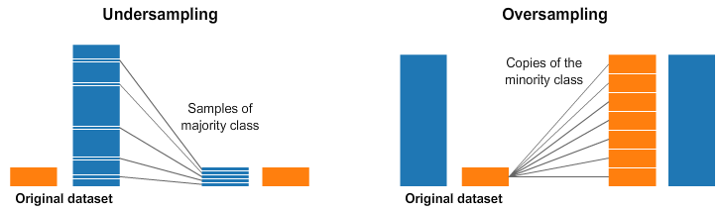
How to handle imbalance data
Resampling technique
Under sampling
Random under sampling
Over sampling
SMOTE
Borderline-SMOTE
ANASYN
Synthetic observation

Slide 8
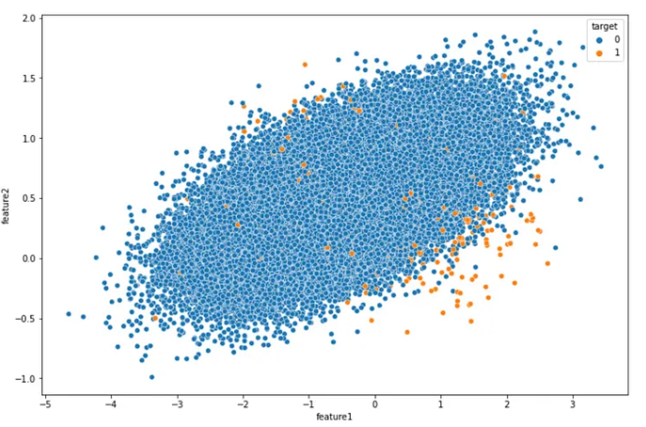
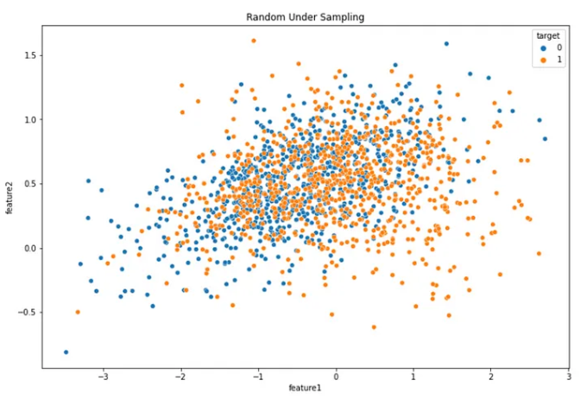
How to handle imbalance data
Random under sampling

Slide 9
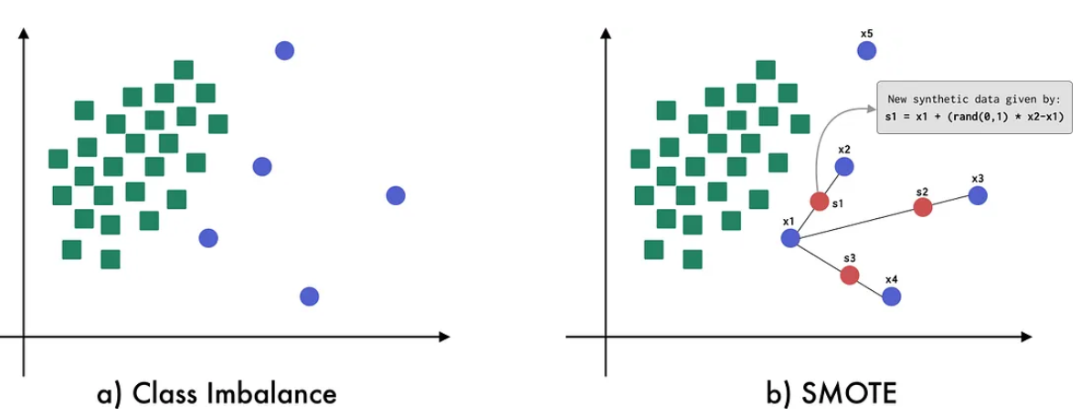
How to handle imbalance data
SMOTE (Synthetic Minority Over-sampling Technique)

Slide 10
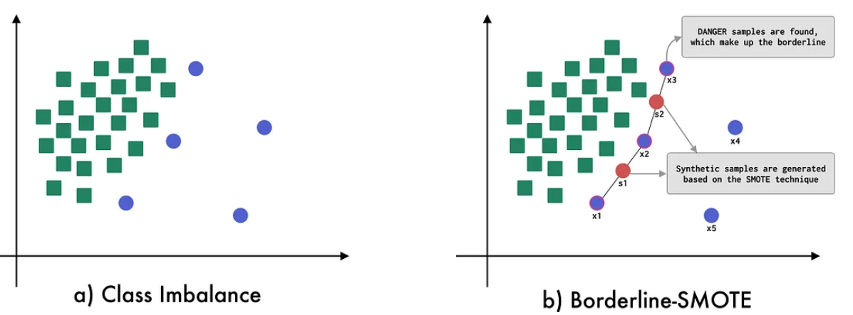
How to handle imbalance data
Borderline-SMOTE

Slide 11
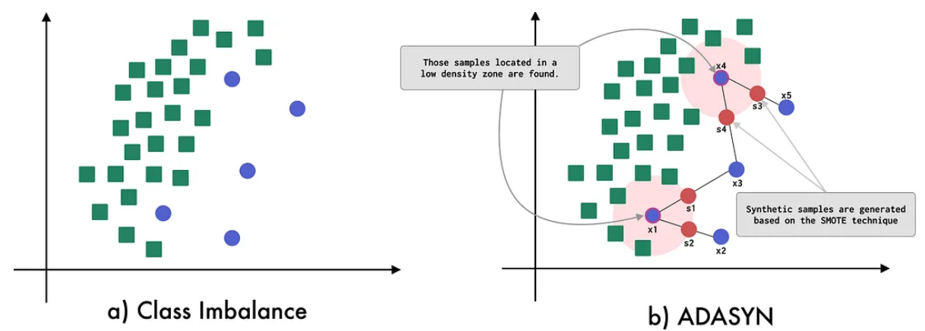
How to handle imbalance data
ADASYN

Slide 12

How to handle imbalance data
Algorithm-level method
Cost-sensitive learning (adjust class weight)
Evaluation metrics adjustment
Accuracy
Precision and Recall
F-beta
ROC-AUC
PR-AUC

Slide 13
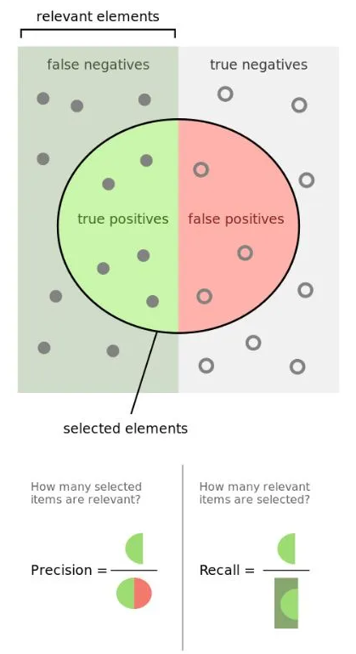
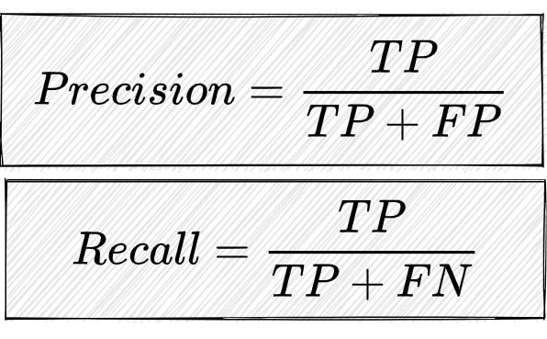
How to handle imbalance data
Precision and recall

Slide 14
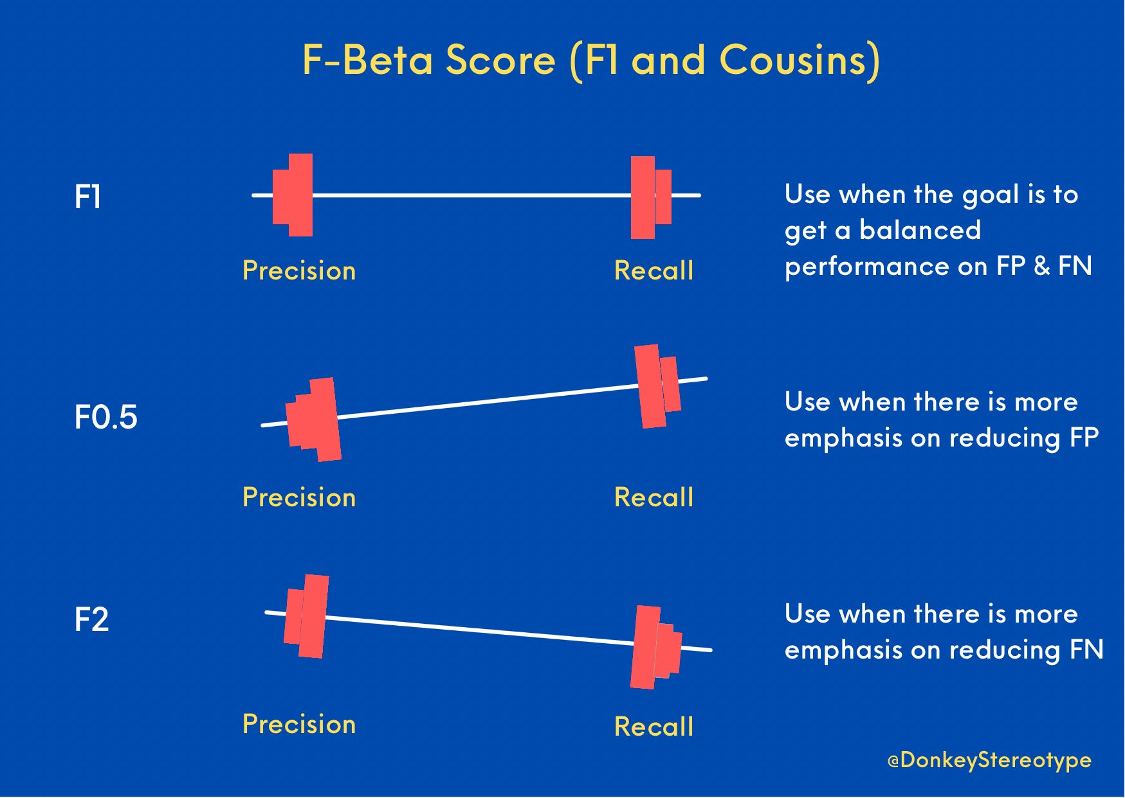
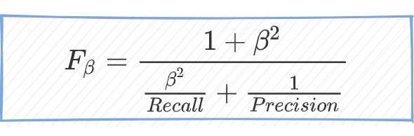
How to handle imbalance data
F-beta

Slide 15
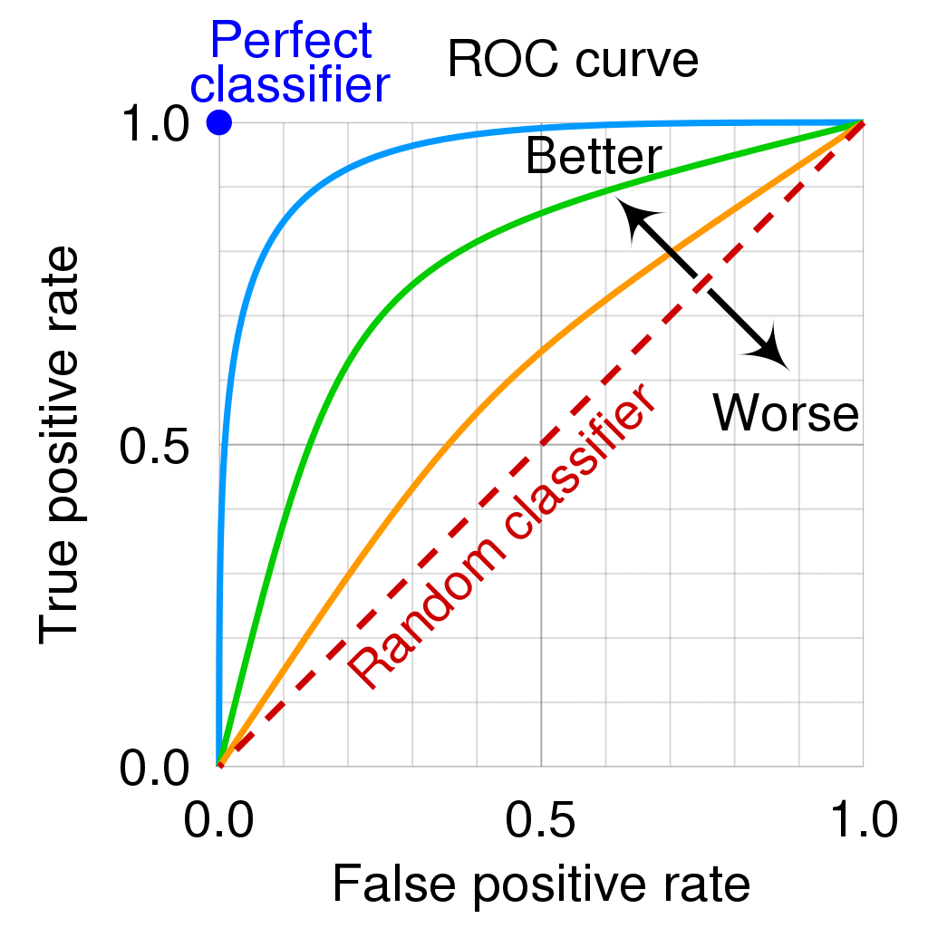
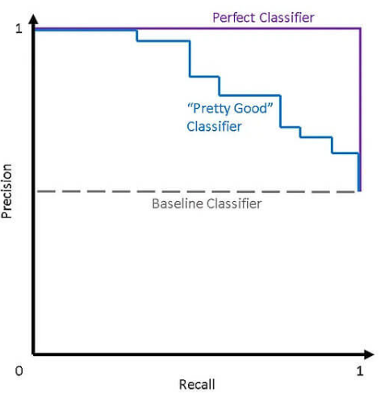
How to handle imbalance data
ROC-AUC and PR-AUC

Slide 16

How to handle imbalance data
Hybrid method
Combining several techniques
No free lunch theorem**

Slide 17
Show case
Telco churn prediction
Bitcoin false signal trading system detection

Slide 18
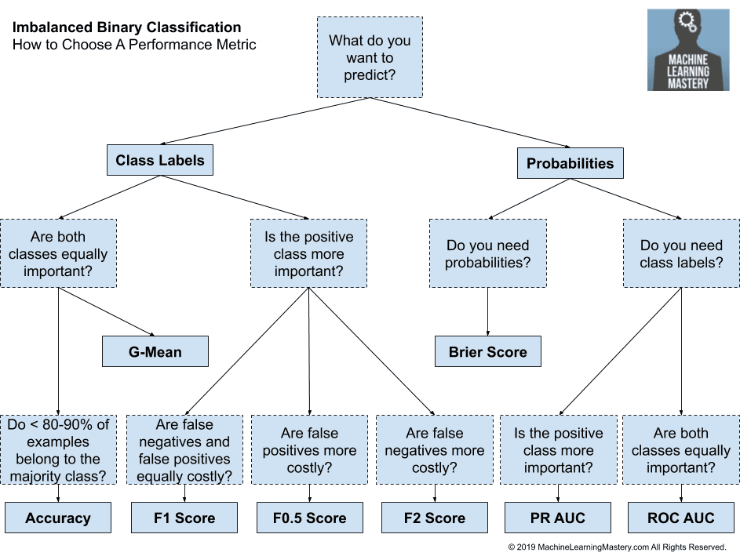
Further reading
Multi-class imbalance data
Performance metrics
Imbalance in regression
Over under sampling

Slide 19
Appendix
The 5 Most Useful Techniques to Handle Imbalanced Datasets – Kdnuggets
Resampling strategies for imbalanced datasets (kaggle.com)
Four Oversampling and Under-Sampling Methods for Imbalanced Classification Using Python | by Amy @GrabNGoInfo | GrabNGoInfo | Medium
SMOTE: Synthetic Data Augmentation for Tabular Data | by Fernando López | Towards Data Science
Tour of Evaluation Metrics for Imbalanced Classification - MachineLearningMastery.com
Is F1 the appropriate criterion to use? What about F2, F3,…, F beta? | by Dr Barak Or | Towards Data Science
How to Deal With Imbalanced Classification and Regression Data (neptune.ai)

